Slide 1
Lecture 7: Computational Graph and Neural Network
Instructor: Yang Xu

Slide 2
Recap
Evaluation of ML models
Train/dev/test
Performance of classification models
TP, TN, FP, FN
Accuracy, Precision, Recall, F1 score
Overfitting
L2 regularization
Minimize(Cost + Complexity)

Slide 3
Outline
Computation graph basic concepts
Vectorization of logistic regression
One hidden layer neural network

Slide 4
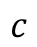
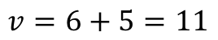
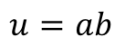
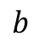
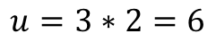
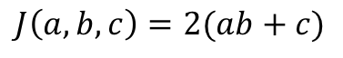
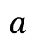
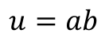
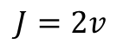
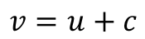
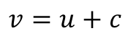
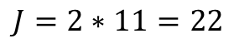
Computation Graph
What is it?
A useful tool to understand/visualize ML models
Simple arithmetic example
$$J\left(a,b,c\right)=2(ab+c)$$
Set intermediate variables
$$u=ab$$
$$v=u+c$$
3
$$a$$
$$u=3∗2=6$$
$$u=ab$$
$$v=6+5=11$$
$$J=2∗11=22$$
2
$$b$$
$$v=u+c$$
$$J=2v$$
5
$$c$$

Slide 5
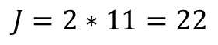
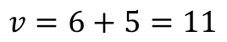
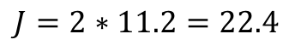
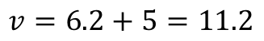
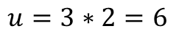
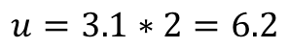
Input change leads to output change
3
$$a$$
$$u=3∗2=6$$
$$u=ab$$
$$v=6+5=11$$
$$J=2∗11=22$$
2
$$b$$
$$v=u+c$$
$$J=2v$$
5
$$c$$
How much will $J$ change if $a$ changes a little bit?
3.1
$$a$$
$$u=3.1∗2=6.2$$
$$u=ab$$
$$v=6.2+5=11.2$$
$$J=2∗11.2=22.4$$
2
$$b$$
$$v=u+c$$
$$J=2v$$
5
$$c$$

Slide 6
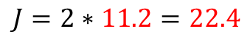
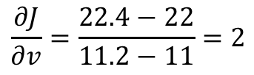
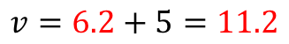
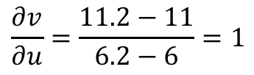

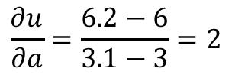
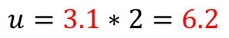

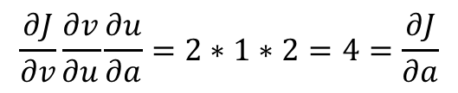
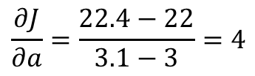
Derivative of $J$ w.r.t $a$
3.1
$$a$$
$$u=3.1∗2=6.2$$
$$u=ab$$
$$v=6.2+5=11.2$$
$$J=2∗11.2=22.4$$
2
$$b$$
$$v=u+c$$
$$J=2v$$
5
$$c$$
$$\frac{∂J}{∂a}=\frac{22.4−22}{3.1−3}=4$$
$J$ will change by 4 units if $a$ changes by 1
What about going Backward step by step:
$$\frac{∂u}{∂a}=\frac{6.2−6}{3.1−3}=2$$
$$\frac{∂v}{∂u}=\frac{11.2−11}{6.2−6}=1$$
$$\frac{∂J}{∂v}=\frac{22.4−22}{11.2−11}=2$$
Apply chain rule:
$$\frac{∂J}{∂v}\frac{∂v}{∂u}\frac{∂u}{∂a}=2∗1∗2=4=\frac{∂J}{∂a}$$

Slide 7

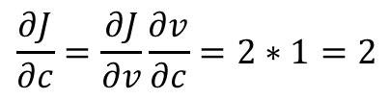

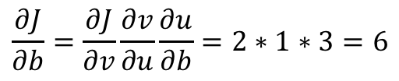
Derivative of $J$ w.r.t all inputs
3
$$a$$
$$u=ab$$
2
$$b$$
$$v=u+c$$
$$J=2v$$
5
$$c$$
$$\frac{∂J}{∂b}=\frac{∂J}{∂v}\frac{∂v}{∂u}\frac{∂u}{∂b}=2∗1∗3=6$$
$$\frac{∂J}{∂c}=\frac{∂J}{∂v}\frac{∂v}{∂c}=2∗1=2$$
Forward pass (green), compute the cost $J$
Backward pass (red), compute the derivative $\frac{∂J}{∂?}$

Slide 8
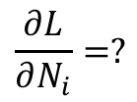
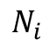
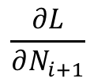

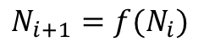
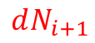
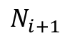
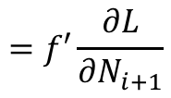

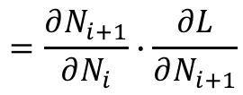
The function of nodes
$$N_{i+1}=f(N_{i})$$
$$f$$
$$N_{i}$$
$$N_{i+1}$$
$$dN_{i}$$
$$dN_{i+1}$$
$$\frac{∂L}{∂N_{i}}=?$$
$$\frac{∂L}{∂N_{i+1}}$$
$$=\frac{∂N_{i+1}}{∂N_{i}}∙\frac{∂L}{∂N_{i+1}}$$
$$=f′\frac{∂L}{∂N_{i+1}}$$

Slide 9
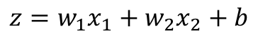
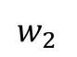
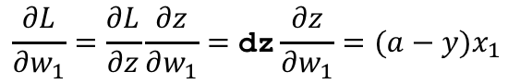
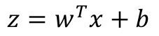
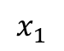
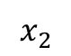
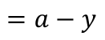
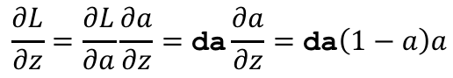

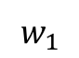
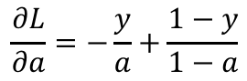
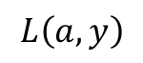
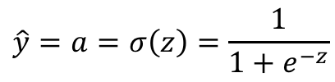
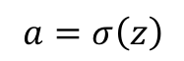
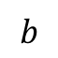

Computation graph for logistic regression
Recap
$a$ for “activation”
$$z=w^{T}x+b$$
loss function $L\left(a,y\right)$
$$\hat{y}=a=σ\left(z\right)=\frac{1}{1+e^{−z}}$$
= The cost of a single training example
$$L\left(a,y\right)=−(y\log{(a)}+\left(1−y\right)\log{(1−a)})$$
“dw₁”
$$x_{1}$$
$$\frac{∂L}{∂w_{1}}=\frac{∂L}{∂z}\frac{∂z}{∂w_{1}}=\text{dz}\frac{∂z}{∂w_{1}}=(a−y)x_{1}$$
$$w_{1}$$
$$x_{2}$$
$$z=w_{1}x_{1}+w_{2}x_{2}+b$$
$$a=σ\left(z\right)$$
$$L\left(a,y\right)$$
$$w_{2}$$
$$\frac{∂L}{∂z}=\frac{∂L}{∂a}\frac{∂a}{∂z}=\text{da}\frac{∂a}{∂z}=\text{da}\left(1−a\right)a$$
$$\frac{∂L}{∂a}=−\frac{y}{a}+\frac{1−y}{1−a}$$
$$b$$
“dz”
$$=a−y$$
“da” for short

Slide 10






Compute gradients for m examples
Cost function:
$$J\left(w,b\right)=\frac{1}{m}\sum_{i}{L(a^{\left(i\right)}−y^{(i)})}$$
$$⇒\frac{∂J(w,b)}{∂w_{1}}=\frac{1}{m}\sum_{i}{\frac{∂}{∂w_{1}}L(a^{\left(i\right)}−y^{(i)})}=\frac{1}{m}\sum_{i}{dw_{1}^{(i)}}$$
Implementation with for loops
$dw_{1}=0$; $dw_{2}=0$; … $dw_{n}=0$, $db=0$
For $i$ = 1 to m:
$z^{(i)}=w^{T}x^{(i)}+b$
$a^{(i)}=σ(z^{(i)})$
${dz}^{(i)}=a^{(i)}−y^{(i)}$
For $j$ = 1 to n:
${dw}_{j}+=x_{j}^{(i)}{dz}^{(i)}$
$db+={dz}^{(i)}$
$dw_{1}=\frac{dw_{1}}{m}$; $dw_{2}=\frac{dw_{2}}{m}$; … $dw_{n}=\frac{dw_{n}}{m}$, $db=\frac{db}{m}$
$$w_{1}=w_{1}−α\text{dw}\text{1}$$
Forward
Vectorization needed!
$$w_{2}=w_{2}−α\text{dw}\text{2}$$
$$b=b−α\text{db}$$
Backward

Slide 11


Vectorization
$$z=w^{T}x+b$$
$$w∈ℝ^{n},x∈ℝ^{n}$$
Non-vectorized code
Vectorized code
z = 0
for i in range(n):
z += w[i]*x[i] z += b
z = np.dot(w, x) + b
This is way faster!
Because CPU/GPU has parallelization instructions, SIMD (single instruction multiple data).
Parallelism is enable in built-in function such as np.dot()

Slide 12

Demo: vectorization vs. non-vectorization
Vectorization is more than X300 faster
Whenever possible, avoid using explicit for loops

Slide 13





Vectorize logistic regression (forward)
$$z^{(1)}=w^{T}x^{(1)}+b$$
$$a^{(1)}=σ(z^{(1)})$$
$$z^{(2)}=w^{T}x^{(2)}+b$$
$$a^{(2)}=σ(z^{(2)})$$
…
$$z^{(m)}=w^{T}x^{(m)}+b$$
$$a^{(m)}=σ(z^{(m)})$$
$$Z=$$
$$[z^{(1)},z^{(2)},⋯,z^{(m)}]=w^{T}X+[b,b,⋯,b]$$
One line numpy command:
Z = np.dot(w.T, X) + b
Automatic “broadcast” form number to vector
$$A=\left[a^{\left(1\right)},a^{\left(2\right)},⋯,a^{\left(m\right)}\right]=[σ(z^{\left(1\right)}),σ(z^{\left(2\right)}),⋯,{σ(z}^{\left(m\right)})]$$
numpy command:
A = 1 / (1+np.exp(-Z))

Slide 14







Vectorizing gradient computation (backward)
$$dz^{(2)}=a^{(2)}−y^{(2)}$$
…
$$dz^{(1)}=a^{(1)}−y^{(1)}$$
$$dz^{(m)}=a^{(m)}−y^{(m)}$$
Vectorize:
$$A=\left[a^{\left(1\right)},a^{\left(2\right)},⋯,a^{\left(m\right)}\right]$$
$$Y=\left[y^{\left(1\right)},y^{\left(2\right)},⋯,y^{\left(m\right)}\right]$$
$$dZ=A−Y=[a^{\left(1\right)}−y^{\left(1\right)},a^{\left(2\right)}−y^{\left(2\right)},⋯,a^{\left(m\right)}−y^{\left(m\right)}]$$
$dw_{1}=0$; $dw_{2}=0$; … $dw_{n}=0$, $db=0$
For $i$ = 1 to m:
$z^{(i)}=w^{T}x^{(i)}+b$
$a^{(i)}=σ(z^{(i)})$
${dz}^{(i)}=a^{(i)}−y^{(i)}$
For $j$ = 1 to n:
${dw}_{j}+=x_{j}^{(i)}{dz}^{(i)}$
$db+={dz}^{(i)}$
$dw_{1}=\frac{dw_{1}}{m}$; $dw_{2}=\frac{dw_{2}}{m}$; … $dw_{n}=\frac{dw_{n}}{m}$, $db=\frac{db}{m}$
$$db=\frac{1}{m}\sum_{i}{{dz}^{(i)}}$$
numpy:
db = np.sum(dZ) / m
What about dw?

Slide 15


Vectorizing gradient computation (cont.)
$dw_{1}=0$; $dw_{2}=0$; … $dw_{n}=0$, $db=0$
For $i$ = 1 to m:
$z^{(i)}=w^{T}x^{(i)}+b$
$a^{(i)}=σ(z^{(i)})$
${dz}^{(i)}=a^{(i)}−y^{(i)}$
For $j$ = 1 to n:
${dw}_{j}+=x_{j}^{(i)}{dz}^{(i)}$
$db+={dz}^{(i)}$
$dw_{1}=\frac{dw_{1}}{m}$; $dw_{2}=\frac{dw_{2}}{m}$; … $dw_{n}=\frac{dw_{n}}{m}$, $db=\frac{db}{m}$
$$dw=\frac{1}{m}X{dz}^{T}$$

Slide 16










Vectorizing logistic regression (recap)
$$dw=\frac{1}{m}X{dZ}^{T}$$
$$w$$
$$dZ=A−Y$$
$$X$$
$$Z=w^{T}X+b$$
$$A=σ\left(Z\right)$$
$$J=∑L$$
$$b$$
$db=\frac{1}{m}$ np.sum(dZ)
Gradient descent
Repeat until s.t. {
$Z=w^{T}X+b$
$A=σ\left(Z\right)$
$dZ=A−Y$
$dw=\frac{1}{m}X{dZ}^{T}$
$db=\frac{1}{m}$ np.sum(dZ)
$w=w−αdw$
$b=b−αdb$
}
For loop →

Slide 17








Wrapped into a single unit
$$x_{1}$$
$$w_{1}$$
$$x_{2}$$
$$z=w_{1}x_{1}+w_{2}x_{2}+b$$
$$a=σ\left(z\right)$$
$$L\left(a,y\right)$$
$$w_{2}$$
$$b$$
$$x_{1}$$
$$z=w^{T}x+b$$
$$x_{2}$$
$$z$$
$$a$$
$$a=\hat{y}$$
$$a=σ(z)$$
$$x_{3}$$

Slide 18




















A neural network
$$z_{1}^{[1]}$$
$$a_{1}^{[1]}$$
$$x_{1}$$
$$z_{2}^{[1]}$$
$$a_{2}^{[1]}$$
$$z^{[2]}$$
$$a^{[2]}$$
$$x_{2}$$
$$\hat{y}$$
$$z_{3}^{[1]}$$
$$a_{3}^{[1]}$$
$$x_{3}$$
$$z_{1}^{[1]}=w_{1}^{\left[1\right]T}x+b_{1}^{[1]}$$
$$a_{1}^{[1]}=σ(z_{1}^{[1]})$$
$$z^{[2]}=w^{[2]T}a^{[1]}+b^{[2]}$$
$$z_{2}^{[1]}=w_{2}^{\left[1\right]T}x+b_{2}^{[1]}$$
$$a_{2}^{[1]}=σ(z_{2}^{[1]})$$
$$a^{[2]}=σ(z^{[2]})$$
$$z_{3}^{[1]}=w_{3}^{\left[1\right]T}x+b_{3}^{[1]}$$
$$a_{3}^{[1]}=σ(z_{3}^{[1]})$$

Slide 19















Formal definition
$$W^{[1]}, b^{[1]}$$
Notation
$$a_{i}^{\left[l\right]}$$
$$a^{[1]}$$
Activation of $i$th unit of $l$th layer.
$$a^{[0]}=x$$
$$a_{1}^{\left[1\right]}$$
$$x_{1}$$
$$W^{[2]}, b^{[2]}$$
$$a_{2}^{\left[1\right]}$$
$$x_{2}$$
$$a^{[2]}$$
$$\hat{y}$$
$$a_{3}^{\left[1\right]}$$
$$x_{3}$$
“Two-layer” neural network
$$a_{4}^{\left[1\right]}$$
Input layer
Hidden layer
Output layer

Slide 20



















Parameters
$$W^{[1]}=\left[\begin{matrix}W_{11}^{[1]} \\ W_{21}^{[1]} \\ \begin{aligned}W_{31}^{[1]} \\ W_{41}^{[1]}\end{aligned}\end{matrix}\begin{matrix}\begin{aligned}W_{12}^{[1]} \\ W_{22}^{[1]}\end{aligned} \\ W_{32}^{[1]} \\ W_{42}^{[1]}\end{matrix}\begin{matrix}W_{13}^{[1]} \\ \begin{aligned}W_{23}^{[1]} \\ W_{33}^{[1]}\end{aligned} \\ W_{43}^{[1]}\end{matrix}\right]∈ℝ^{4×3}$$
$$b^{[1]}=\left[\begin{matrix}b_{1}^{[1]} \\ \begin{aligned}b_{2}^{[1]} \\ b_{3}^{[1]}\end{aligned} \\ b_{4}^{[1]}\end{matrix}\right]∈ℝ^{4×1}$$
$$W^{[1]}, b^{[1]}$$
$$W_{11}^{[1]}$$
$$a_{1}^{\left[1\right]}$$
$$x_{1}$$
$$W_{12}^{[1]}$$
$W_{ij}^{[l]}$ is the weight connecting the $j$th unit in layer $l−1$ to the $i$th unit in layer $l$
$$W_{13}^{[1]}$$
$$a_{2}^{\left[1\right]}$$
$$W^{[2]}, b^{[2]}$$
$$x_{2}$$
$$a^{[2]}$$
$$\hat{y}$$
$$a_{3}^{\left[1\right]}$$
$$x_{3}$$
$$W^{[2]}=[W_{11}^{\left[2\right]},W_{12}^{\left[2\right]},W_{13}^{\left[2\right]},W_{14}^{[2]}]∈ℝ^{1×4}$$
$$b^{[2]}∈ℝ^{1×1}$$
$$a_{4}^{\left[1\right]}$$
$$1$$

Slide 21



















Computing output (one training example)
$$z_{1}^{[1]}=w_{1}^{\left[1\right]T}x+b_{1}^{[1]}$$
$$x_{1}$$
$$x_{1}$$
$$a_{1}^{[1]}=σ(z_{1}^{[1]})$$
$$z=w^{T}x+b$$
$$x_{2}$$
$$\hat{y}$$
$$x_{2}$$
$$z$$
$$a$$
$$a=\hat{y}$$
$$x_{3}$$
$$a=σ(z)$$
$$x_{3}$$
$$z_{2}^{[1]}=w_{2}^{\left[1\right]T}x+b_{2}^{[1]}$$
$$a_{2}^{[1]}=σ(z_{2}^{[1]})$$
$$x_{1}$$
$$x_{2}$$
$$\hat{y}$$
$$x_{3}$$

Slide 22















Vector representation
$$a_{1}^{[1]}$$
$$z_{1}^{[1]}=w_{1}^{\left[1\right]T}x+b_{1}^{[1]}, a_{1}^{[1]}=σ(z_{1}^{[1]})$$
$$x_{1}$$
$$a_{2}^{[1]}$$
$$z_{2}^{[1]}=w_{2}^{\left[1\right]T}x+b_{2}^{[1]}, a_{2}^{[1]}=σ(z_{2}^{[1]})$$
$$x_{2}$$
$$\hat{y}$$
$$z_{3}^{[1]}=w_{3}^{\left[1\right]T}x+b_{3}^{[1]}, a_{3}^{[1]}=σ(z_{3}^{[1]})$$
$$a_{3}^{[1]}$$
$$x_{3}$$
$$z_{4}^{[1]}=w_{4}^{\left[1\right]T}x+b_{4}^{[1]}, a_{4}^{[1]}=σ(z_{4}^{[1]})$$
$$a_{4}^{[1]}$$
$$4×1$$
$$4×3$$
$$3×1$$
$$4×1$$
$$W^{[1]}$$
$$b^{[1]}$$
$$4×1$$

Slide 23






















Vector representation (cont.)
$$a_{1}^{[1]}$$
Layer 1:
$$z^{[1]}=W^{[1]}x+b^{[1]}$$
$$a^{[1]}=σ(z^{[1]})$$
$$x_{1}$$
$$4×1$$
$$4×3$$
$$3×1$$
$$4×1$$
$$4×1$$
$$a_{2}^{[1]}$$
Layer 2:
$$z^{[2]}=W^{[2]}a^{[1]}+b^{[2]}$$
$$a^{[2]}=σ(z^{[2]})$$
$$x_{2}$$
$$\hat{y}$$
$$1×1$$
$$1×4$$
$$4×1$$
$$1×1$$
$$1×1$$
$$a_{3}^{[1]}$$
$$x_{3}$$
$$a_{4}^{[1]}$$
$$W^{[2]}, b^{[2]}$$
$$W^{[1]}, b^{[1]}$$
General principle for dimensions
$$W^{[1]}=\left[\begin{matrix}W_{11}^{[1]} \\ W_{21}^{[1]} \\ \begin{aligned}W_{31}^{[1]} \\ W_{41}^{[1]}\end{aligned}\end{matrix}\begin{matrix}\begin{aligned}W_{12}^{[1]} \\ W_{22}^{[1]}\end{aligned} \\ W_{32}^{[1]} \\ W_{42}^{[1]}\end{matrix}\begin{matrix}W_{13}^{[1]} \\ \begin{aligned}W_{23}^{[1]} \\ W_{33}^{[1]}\end{aligned} \\ W_{43}^{[1]}\end{matrix}\right]$$
$$b^{[1]}=\left[\begin{matrix}b_{1}^{[1]} \\ \begin{aligned}b_{2}^{[1]} \\ b_{3}^{[1]}\end{aligned} \\ b_{4}^{[1]}\end{matrix}\right]$$
$$z^{[l]}=W^{[l]}a^{[l−1]}+b^{[l]}$$
$n^{[l]}$: number of units in layer $l$
$$n^{[l]}×1$$
$$n^{[l]}×n^{[l−1]}$$
$$n^{[l−1]}×1$$
$$n^{[l]}×1$$
$$a^{[l]}=σ(z^{[l]})$$
$$W^{[2]}=[W_{11}^{\left[2\right]},W_{12}^{\left[2\right]},W_{13}^{\left[2\right]},W_{14}^{[2]}]$$
$$b^{[2]}$$

Slide 24














Vectorizing multiple examples
$$z^{[1]}=W^{[1]}x+b^{[1]}$$
$$a^{[1]}=σ(z^{[1]})$$
$$x_{1}$$
$$z^{[2]}=W^{[2]}a^{[1]}+b^{[2]}$$
$$a^{[2]}=σ(z^{[2]})$$
$$x_{2}$$
$$\hat{y}$$
$$x_{3}$$
m training examples
For i = 1 to m:
$z^{[1](i)}=W^{[1]}x^{(i)}+b^{[1]}$
$a^{[1](i)}=σ(z^{[1](i)})$
$z^{[2](i)}=W^{[2]}a^{[1](i)}+b^{[2]}$
$a^{[2](i)}=σ(z^{[2](i)})$
$$x^{(1)}$$
$$a^{[2](1)}={\hat{y}}^{(1)}$$
$$x^{(2)}$$
$$a^{[2](2)}={\hat{y}}^{(2)}$$
$$x^{(3)}$$
$$a^{[2](3)}={\hat{y}}^{(3)}$$
$$⋮$$
$$x^{(m)}$$
$$a^{[2](m)}={\hat{y}}^{(m)}$$
How to vectorize this for loop?

Slide 25






Vectorizing multiple examples (cont.)
For i = 1 to m:
$z^{[1](i)}=W^{[1]}x^{(i)}+b^{[1]}$
$a^{[1](i)}=σ(z^{[1](i)})$
$z^{[2](i)}=W^{[2]}a^{[1](i)}+b^{[2]}$
$a^{[2](i)}=σ(z^{[2](i)})$
Idea: stack $x^{(i)}$ by columns
Solution:
$$Z^{[1]}=W^{[1]}X+b^{[1]}$$
$$A^{[1]}=σ(Z^{[1]})$$
$$Z^{[2]}=W^{[2]}A^{[1]}+b^{[2]}$$
$$A^{[2]}=σ(Z^{[2]})$$

Slide 26



Explanation on vectorizing
$$z^{[1](1)}=W^{\left[1\right]T}x^{(1)}+b^{[1]}$$
$$z^{[1](2)}=W^{\left[1\right]T}x^{(2)}+b^{[1]}$$
$$z^{[1](2)}=W^{\left[1\right]T}x^{(3)}+b^{[1]}$$

Slide 27
Recap of vectorizing multiple examples
$$x_{1}$$
Instead of one training example at a time
$$x_{2}$$
$$\hat{y}$$
$$x_{3}$$
$$Z^{[1]}=W^{[1]}X+b^{[1]}$$
$$A^{[1]}=σ(Z^{[1]})$$
$$Z^{[2]}=W^{[2]}A^{[1]}+b^{[2]}$$
$$A^{[2]}=σ(Z^{[2]})$$

Slide 28
Why calling it a neural network?
$$x_{1}$$
$$x_{2}$$
$$a=\hat{y}$$
$$x_{3}$$
Just a simplistic analogy to biological neuron

Slide 29
Next lecture
Compute gradients in neural network (Backpropagation)

